Slide 1

Affine Transformation -Translation
By :-
Rahul O S
2023510021
B.Tech Artificial intelligence and data science
Department of Information Technology
Annauniversity – MIT Campus

Slide 2
What is an Affine Transformation?
A linear mapping method that preserves points, straight lines, and planes.
Combines linear transformations (rotation, scaling, shearing) and translation.
Commonly used in image processing, computer graphics, and geometry.
Note :
Affine Transformation is a spatial transformation (i.e. it alters the orientation of the pixel values not the intensity of the pixel values. )

Slide 3
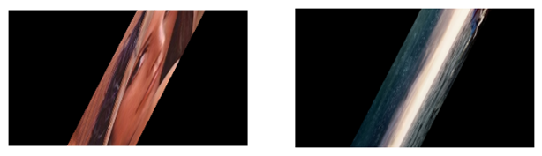
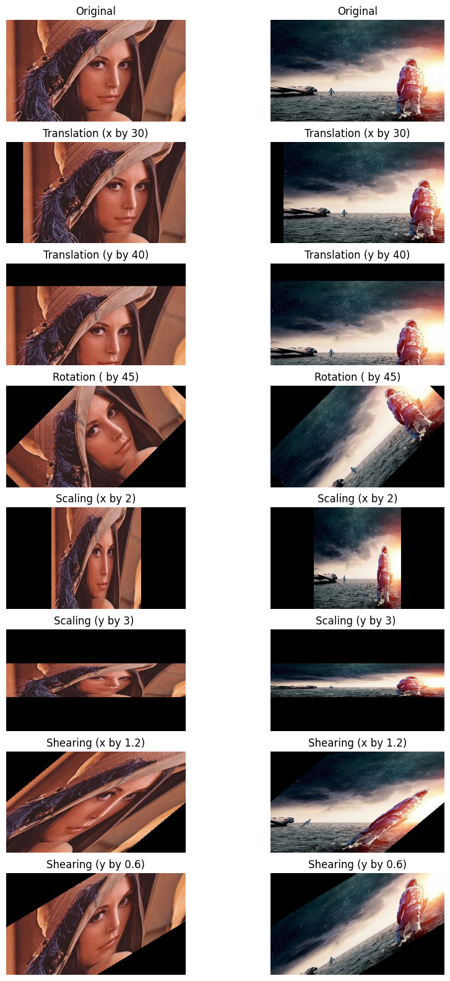
ORIGINAL Image
Transformed Image
Affine
Transformation

Slide 4
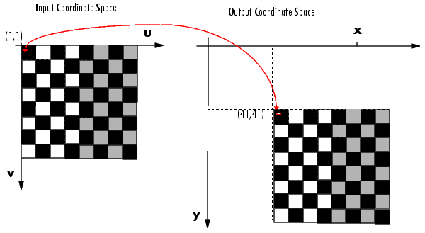
What is Translation ?
It moves every point of an object or image by the same amount in a given direction.
no change in shape, size, or orientation — just a shift in position.
Example: Shifting an image 10 pixels to the right.

Slide 5
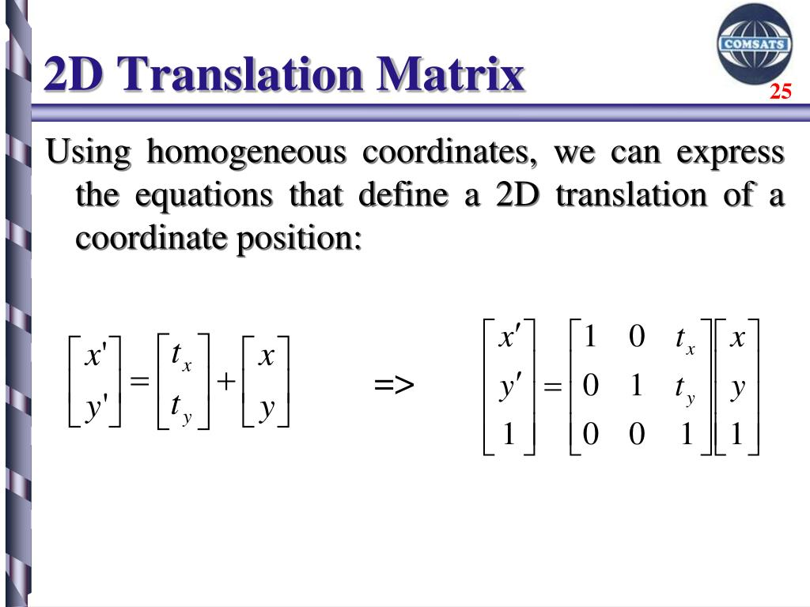
Mathematical Representation :-
As a equation:-
𝑥’ = x + tx
y’ = y + ty
where :-
𝑥′ and 𝑦′ are the coordinates of a pixel 𝑃 in the new image.
𝑥 and 𝑦 are the coordinates of a pixel 𝑃 in the old image.
tx and ty are the distance of which 𝑃 is translated in every direction (i.e. x and y direction).
As a matrix :-
( or )

Slide 6
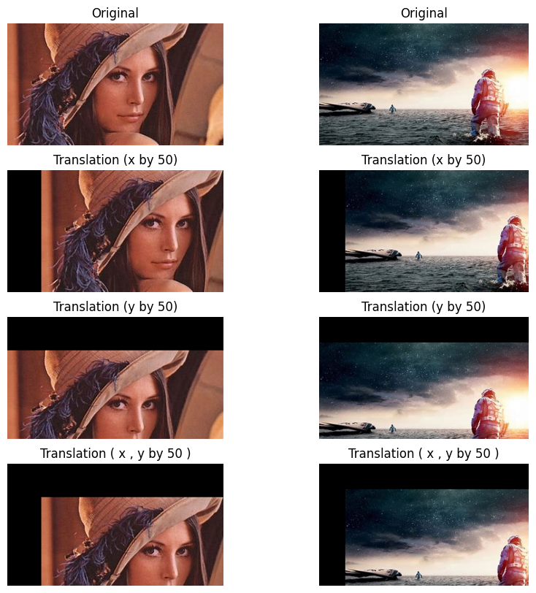
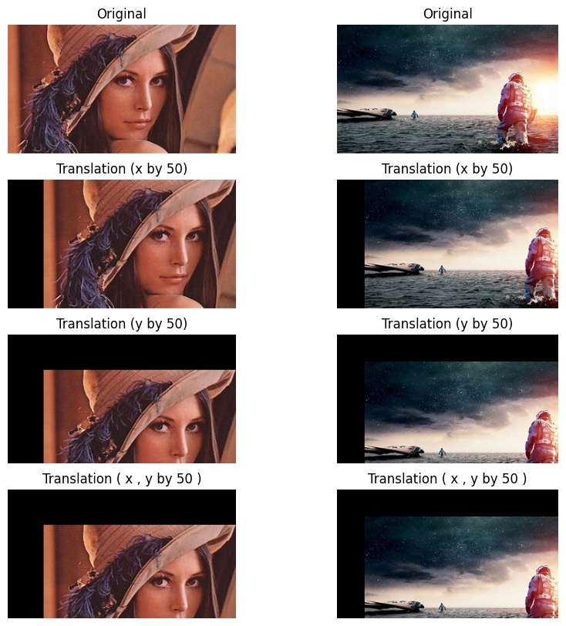

Slide 7
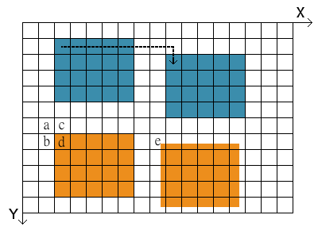
What about if tx and ty are fraction??
The translation of an image with an integer number of pixels is not always this case however. What if the translation in the above figure is not 8 pixels to the right and 1 pixel down, but for example 7.52 right and 0.74 down? A new pixel value needs to be calculated, where the new one would be (but can't be since the coordinate system does not allow it). In order to do that we need to perform an interpolation of the pixel value. In doing this, we calculate the weighted average of the four pixels that are surrounding the point in the old image. This new value is then assigned to the new pixel in the translated image.

Slide 8
REFERENCE :-
Lecture - Image Processing: Geometric Operations - Translation | WueCampus (for interpolation process)
Example: Performing a Translation :: Spatial Transformations (Image Processing Toolbox User's Guide) (for chessboard image in slide 4)
Image Sources:
Lenna image
Frames from Interstellar (used for demonstration)
Thank You

